Slide 1

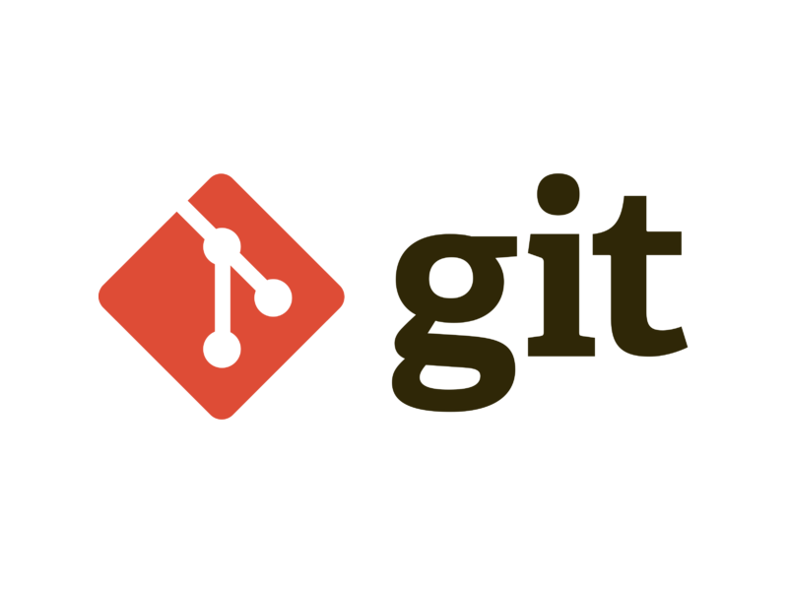
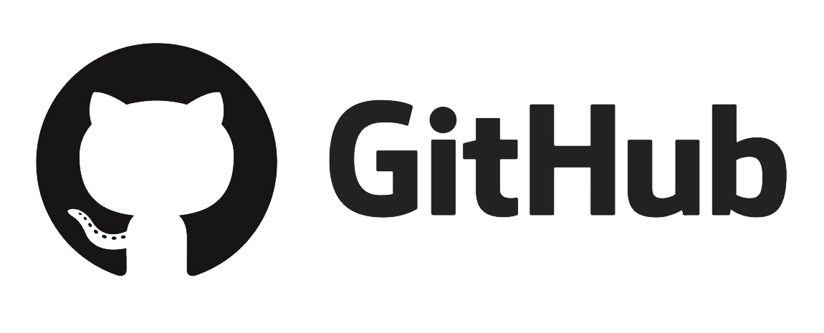
Tutorial On Git
GIT
GITHUB
GITLAB

Slide 2
Index
01. Introduction To Version Control
02. Introduction To Git
What is Version Control?
Centralized v/s Distributed Version Control
What is git?
Some Question Regarding Git?
Install Git
What is Repository?
Architecture?
Git Command pdf
Branching in Git?
What is master and Branch?
03. Introduction To Github & Gitlab

Slide 3
Introduction To Version Control
A Way To Manage Files And Directories
Track Changes Over Time
Recall Previous Versions
Source Control’ Is A Subset Of A VCS.

Slide 4
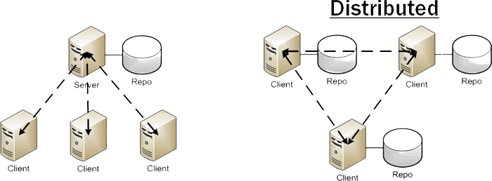
Distributed Version Control VS Traditional Version Control
Traditional Version Control
Distributed Version Control

Slide 5

What is Git?
Git is software for tracking changes in any set of files, usually used for coordinating work among programmers collaboratively developing source code during software development. Its goals include speed, data integrity, and support for distributed, non-linear workflows.
GIT is a distributed Version Control System(DVCS).

Slide 6

What is Git?

Slide 7
Git distributed version control
“If you’re not distributed, you’re not worth using.” – Linus Torvalds
no need to connect to central server
can work without internet connection
no single failure point
developers can work independently and merge their work later
every copy of a Git repository can serve either as the server or as a client (and has complete history!)
Git tracks changes, not versions
Bunch of little change sets floating around

Slide 8








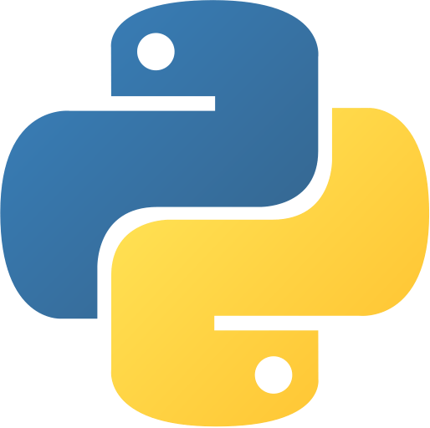

Is Git for me?
People primarily working with source code
Anyone wanting to track edits (especially changes to text files)
- review history of changes
- anyone wanting to share, merge changes
Anyone not afraid of command line tools

Slide 9
Is Git for me?
INSTALLING GIT
TODO:-
1. VERIFY GIT VERSION
2. EXPLORE GIT HELP.
3. CONFIG YOUR USERNAME PASSWORD EMAIL IN DEFAULT GIT EDITOR
4. THEN WE SEE IMPORTANT COMMAND

Slide 10

What is Repository?
What is a repository?
“Repo” = repository
Usually used to organize a single project
Repos can contain folders and files, images, videos, spreadsheets, and data sets – anything your project needs

Slide 11
Three Stage Architecture?
WORKING DIRECTORY
STAGING AREA
GIT ADD
Online REPOSITORY
GIT COMMIT
Local REPOSITORY
GIT push

Slide 12
GitHub, Inc. is a provider of Internet hosting for software development and version control using Git. It offers the distributed version control and source code management functionality of Git, plus its own features.

Slide 13
GitLab is a web-based DevOps lifecycle tool that provides a Git-repository manager providing wiki, issue-tracking and continuous integration and deployment pipeline features, using an open-source license, developed by GitLab Inc.
GitLab

Slide 14
GitLab
V/S

Slide 15
Feature | GitHub | GitLab
Fees | GitHub projects are free and open to all with publicly shared codes. | GitLab is a repository that only lets its team of web developers collaborate on codes.
Location | GitHub doesn’t allow locating a repository inside an organization in the free plan. | GitLab allows its users to locate a repository inside an organization while using the free plan.
Issue Tracker | The issue tracker allows pulling requests so that the raised issues are automatically closed upon being merged to another repose. | Here, the issue tracker allows its users to associate issues with PRs to be closed automatically.
Documentation | GitHub documents are organized in a series of various guides with each guide covers a particular platform. | GitLab documents are similar to documentation for a language with a search bar, listing all the documents required for the installer.
Integration | There is no built-in continuous integration in GitHub. It is provided by third-party vendors. | GitLab offers 100% built-in integration. They favor their own integration tools with continuous developments.
Authentication | Authenticating who can and cannot use the repository can be set according to their role. | Here, a developer has the authority to decide whether someone should access a repository.
Community | GitHub boasts of a large community of developers. It has highly active millions of users to discuss problems with. | GitLab hosts community events connecting contributors with open-source systems.
Platform | It has a development platform used to store projects. It provides features such as task management, bug tracking, etc. | GitLab provides web-based DevOps internal management of repositories.

Slide 16
What Is Branch?
A branch will allows to make a copy while not affecting the original branch.

Slide 17
What Is GitClone?
Git clone is used to create a localcopy of a remote repository

Slide 18


